Slide 1
生成式AI技術與數位行銷人才養成班 人工智慧概論
謝欽旭
國立高雄科技大學電子工程系
2025

Slide 2
PHILOSOPHY OF ARTIFICIAL INTELLIGENCE
Als are designed to mimic human behavior—to calculate the way we do things, or, in the case of androids, to interact with the environment with humanlike agility.
However, as Als become more and more sophisticated, the question arises as to where we should draw the line between the human and the artificial.
Or, to ask the question another way: at what point should we say that an Al is, in fact, a person—has all of the qualities that a human has, and so should be granted rights?
The philosophy of Al addresses this central question. It examines the concepts of free will and consciousness, and asks what the difference is between an intelligence that has evolved biologically and one that has been built by human beings.

Slide 3

HUMANLIKE Al - ARTIFICIAL GENERAL INTELLIGENCE
For many scientists, building an AGI (artificial general intelligence) is the ultimate goal of Al research— although it may never be achieved.
An AGI would be as intelligent as a human being, and may even have other human faculties, such as emotions or even consciousness.
Another name for AGI is "strong Al " a name that contrasts it with ''weak Al," which refers to all other Als that are built to perform specific tasks.
Unlike a weak Al, an AGI would have something like intuition—the ability to know that something is true without resorting to conscious reasoning.

Slide 4
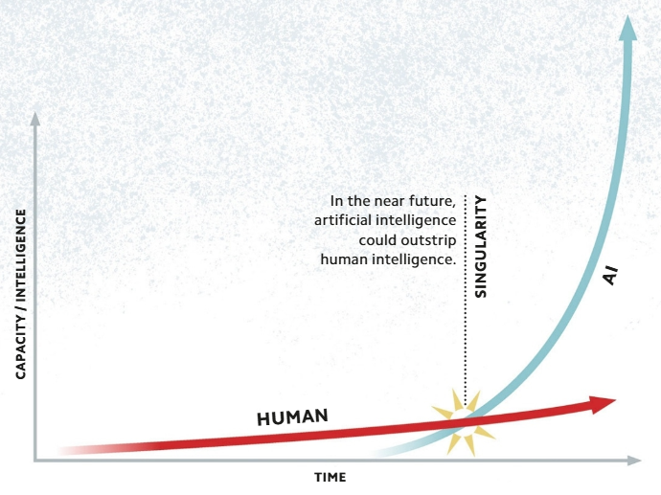
THE POINT OF NO RETURN - THE TECHNOLOGICAL SINGULARITY
In Al, the singularity is the name given to the point in time at which a machine will become as smart as the people who built it, and therefore clever enough to improve itself.
Such a machine would be able to operate at the lightning speeds of a supercomputer, and so would swiftly achieve incredible abilities—including the ability to design Als itself.
The singularity could therefore transform the world in ways that we simply cannot predict.

Slide 5
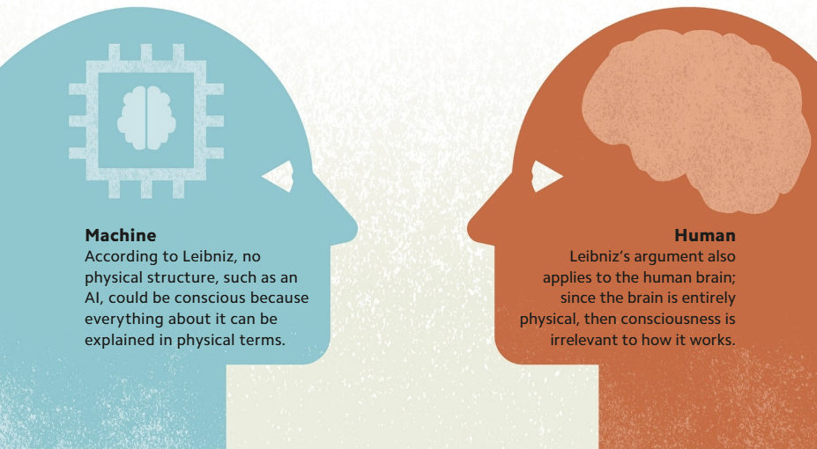
WHERE IS CONSCIOUSNESS? - LEIBNIZ'S QUESTION
For centuries, philosophers have debated the question of how the mind and the brain interact—or, more broadly, how such a thing as consciousness can even exist in a physical world.
However, German philosopher Gottfried Leibniz (1646-1716) argued that if the physical world is mechanical, then the human brain must be linked to the rest of the body by the biological equivalents of cogs and pulleys.
But if that is the case, he argued, then there is no place in the brain for consciousness, which he believed cannot be explained mechanically.

Slide 6
DO SUBMARINES SWIM? - FUNCTIONALISM
Today many scientists argue that debates about how the mind interacts with the body (see opposite) are futile, and that the mind is simply the brain in action—the equivalent of software running on the hardware of the brain.
This approach, known as "functionalism," was summed up by Dutch computer scientist Edsger Dijkstra (1930-2002), who said, "The question of whether computers can think is like the question of whether submarines can swim.“
In other words, whether or not we say that an Al can "think" or be "conscious" is simply a matter of linguistic convention, not one of scientific discovery.
Functionalists focus on what things do rather than what they are—and, they argue if we want to say that submarines "swim," then they swim.

Slide 7
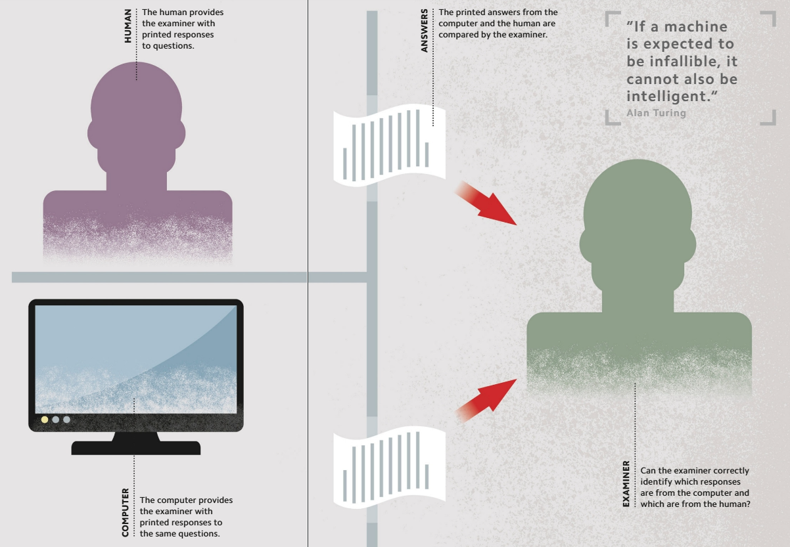
THE IMITATION GAME - THE TURING TEST
Alan Turing devised a test, now called the Turing test, that provides a means for judging whether or not a machine is intelligent.
In the Turing test, both a human and a computer are hidden behind a screen, and an examiner supplies them with mathematical problems to solve.

Slide 8
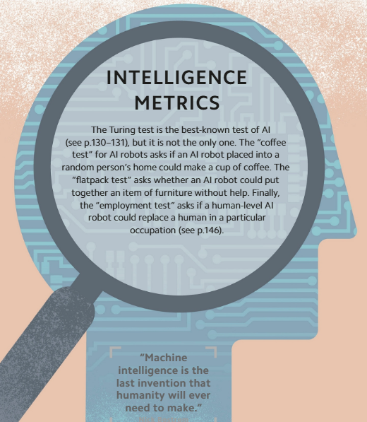
INTELLIGENCE METRICS - INTELLIGENCE TESTS
The "coffee test" for Al robots asks if an Al robot placed into a random person's home could make a cup of coffee.
The "flatpack test" asks whether an Al robot could put together an item of furniture without help.
The "employment test" asks if a human-level Al robot could replace a human in a particular occupation.

Slide 9
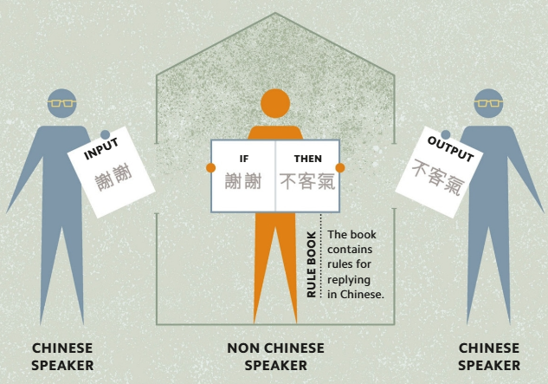
MACHINES AND UNDERSTANDING - THE CHINESE ROOM EXPERIMENT
American philosopher John Searle (1932—) rebutted the idea that machines can think by arguing that while machines follow rules, they are incapable of understanding.
In what he called the "Chinese Room" thought experiment, Searle imagined a person in a room receiving questions written in Chinese. If the person had the appropriate rule book, they would be able to reply to the questions in writing, without actually understanding either the questions or the answers.
Searle argued that to say that a computer can think is similar to saying that the person in the example understands Chinese.

Slide 10
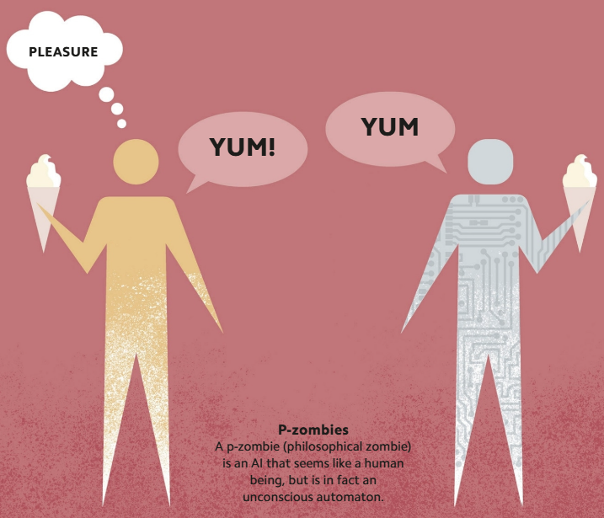
PHILOSOPHICAL ZOMBIES - HUMAN VS MACHINE INTELLIGENCE
Many philosophers question whether an Al could ever be conscious, or be alive in the way that organisms are.
Some claim that such developments are impossible, because Als are entirely mechanical, and are designed specifically to mimic human behavior.
If this is true, then even the most lifelike Als would be like zombies: they would have no “inner life,” and could only ever simulate having emotions, interests, preferences, or opinions.

Slide 11
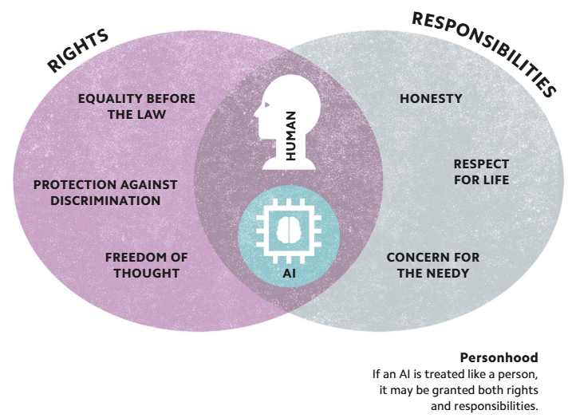
A NEW KIND OF PERSON - Al RIGHTS AND RESPONSIBILITIES
Many scientists argue that, one day, Als will be so lifelike that they should be treated like human beings.
They claim that since humans have rights on the basis that they have free will, Als that pass a “free will test” should therefore have the same protections under law.
This means that, in the future, an Al could claim ownership of its intellectual property, and even be penalized for making mistakes.
Legally, such an Al would no longer be a machine, but a person—effectively, a new kind of human being.

Slide 12
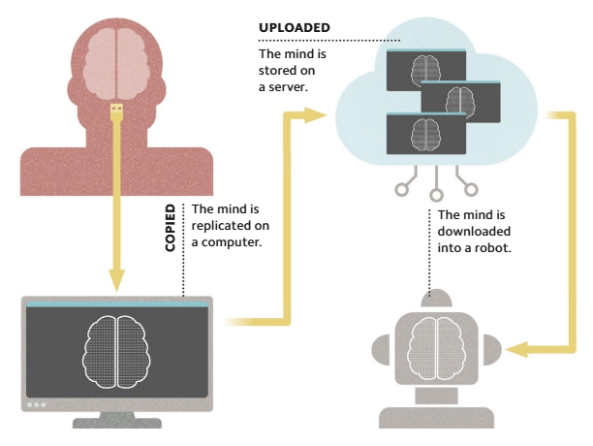
REPLICATING THE MIND - MULTIPLE REALIZABILITY
Computationalists argue that human thought is computable, and so can be realized by a machine as well as a brain.
If this is true, then it should be possible to write a program that replicates a human mind, which could then be copied and transferred like any other program.
This means that a person‘s mind could be uploaded to a remote server, downloaded to a robot, and even duplicated innumerable times.

Slide 13
TRANSPARENT THINKING - OPENING THE BOX
The philosopher Ludwig Wittgenstein (1889-1951) argued that a person‘s thoughts were like objects in a closed box—a box into which only they could "see.“
We can never know what another person is really thinking or exactly what things mean to them, since the "box" is closed to us.
A machine intelligence, however, could be examined in ways a human mind cannot. If the machine said it was thinking of a beetle, its programming could be exposed—“opening the box"—to show precisely what it meant by "beetle.“
Such developments might, in turn, shed light on the mechanisms of human consciousness and thinking.

Slide 14
